Slide 1
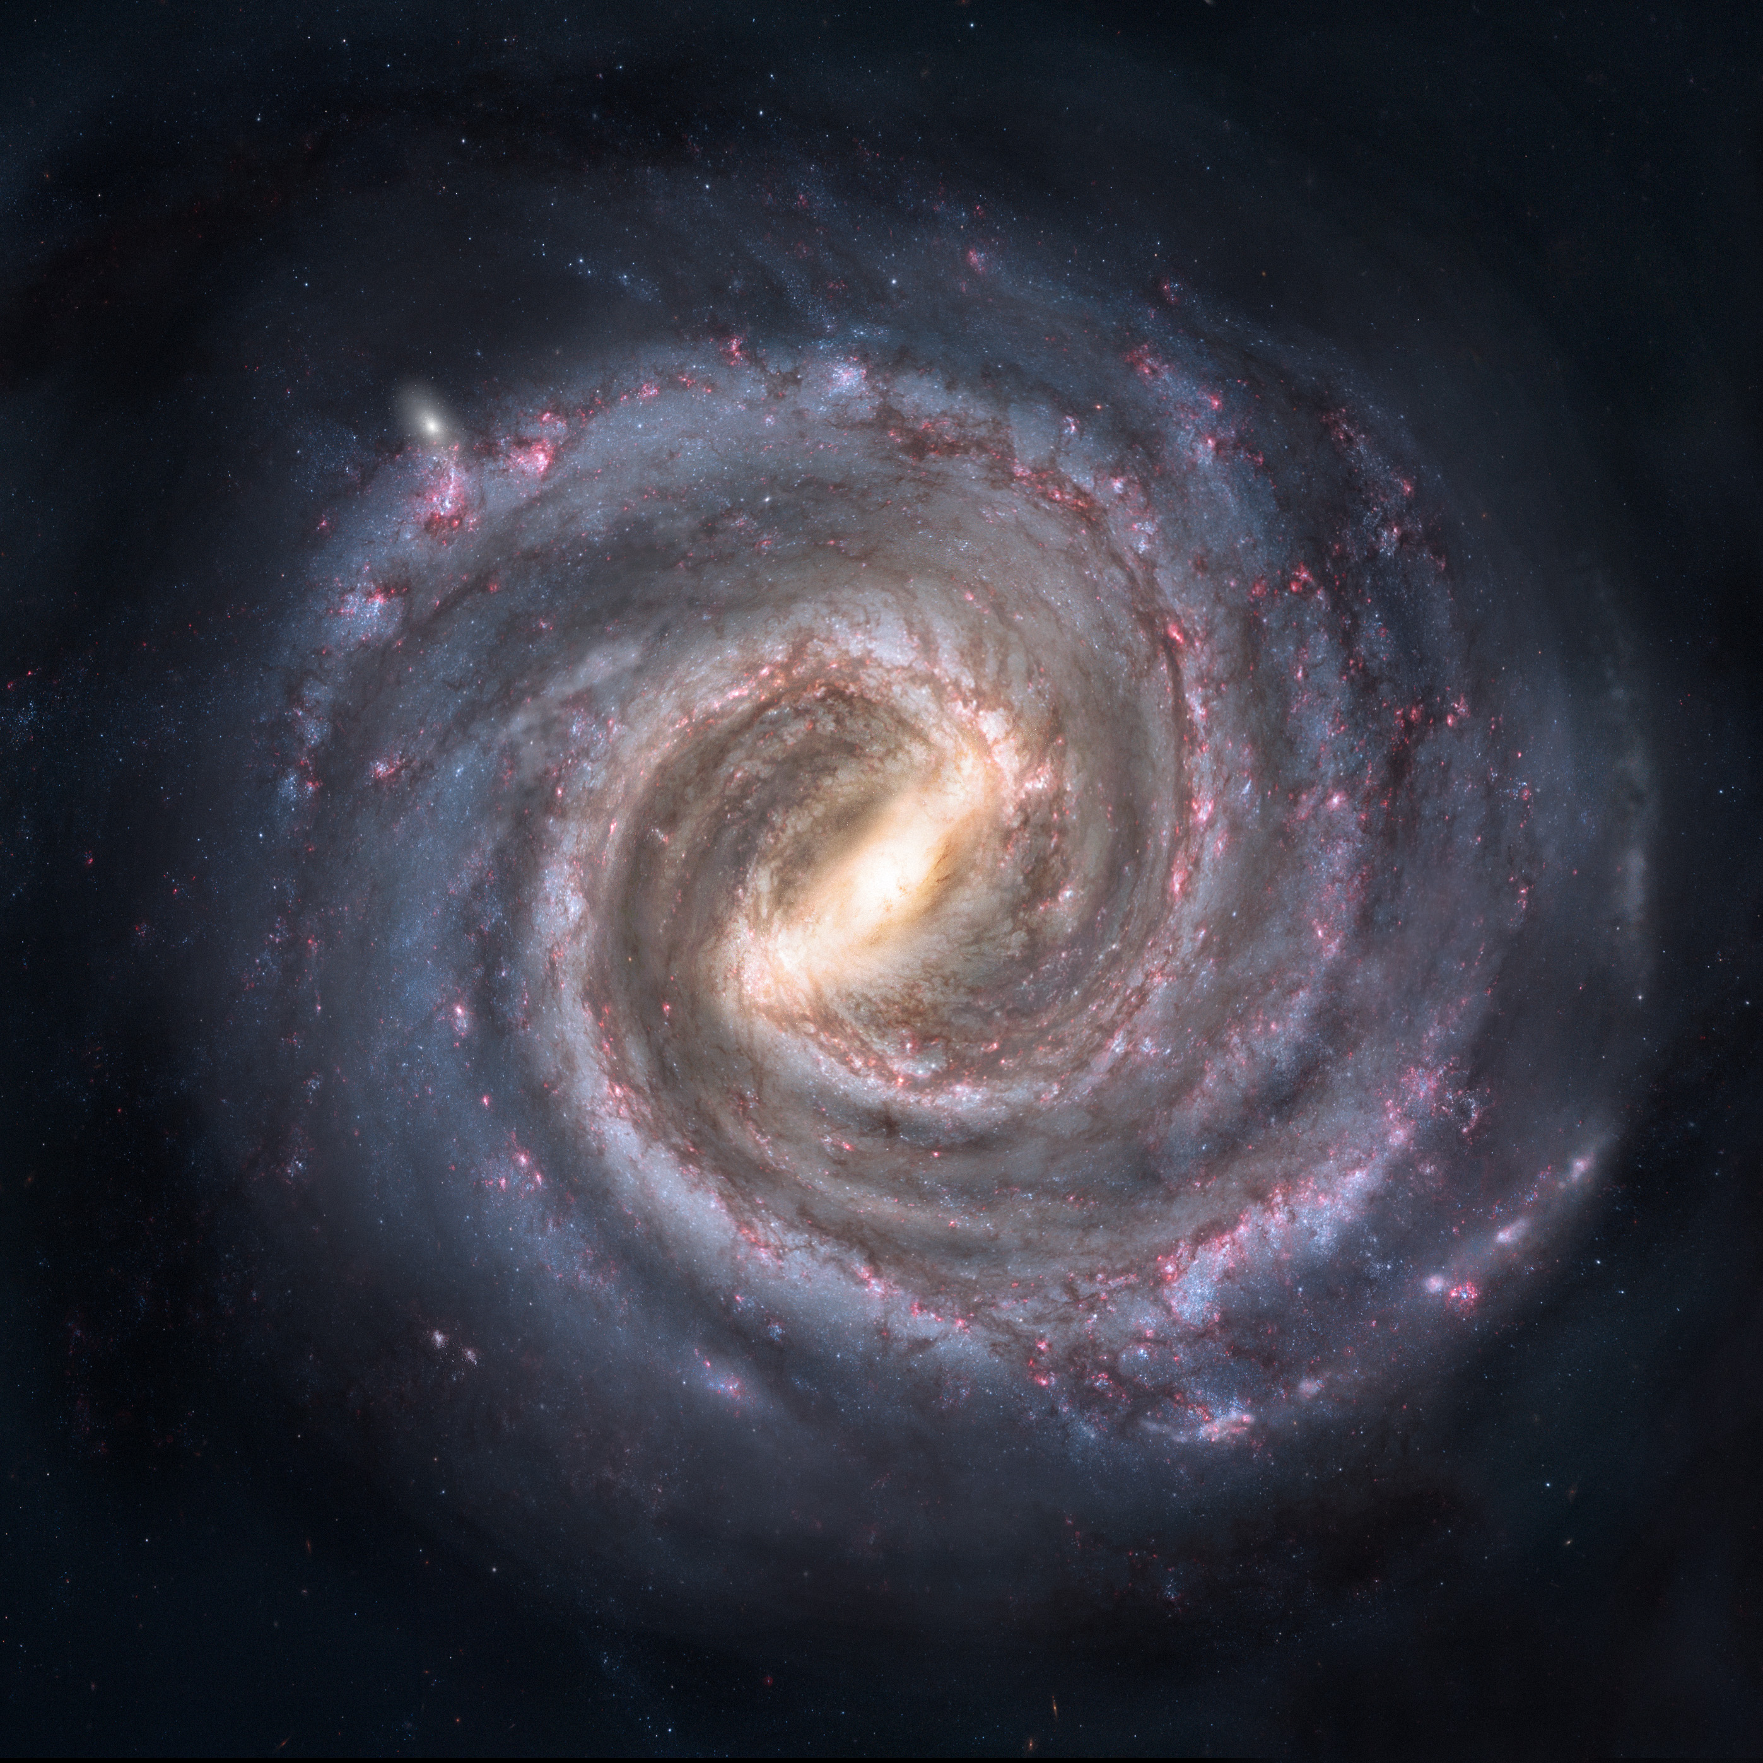

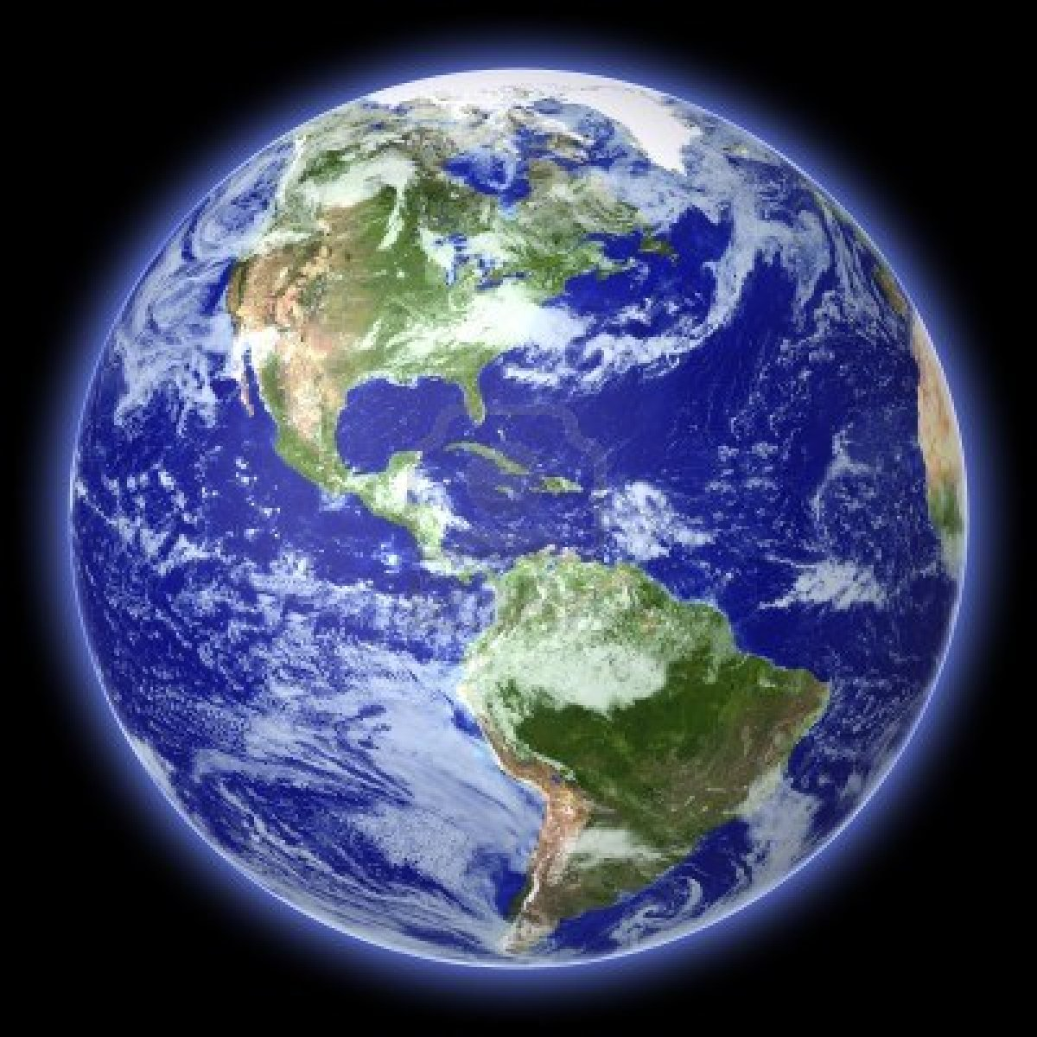
Black Holes and Galaxies and Things Like That
David Starkey
Thursday 28th January 2016
1x10⁵ Light years
Notes:
Milky way – gas – dust –stars -Earth
Black holes lie at the centre of all galaxies and sometimes, they are feeding
Top: - Carina Nebula, an immense cauldron of gas and dust that lies approximately 7500 light-years from Earth in the constellation of Carina, the Keel.
Bot: - 3c273 Quasar (bright AGN).
Point: difficult in early 20th century to distinguish the spectra of stars from AGN.

Slide 3
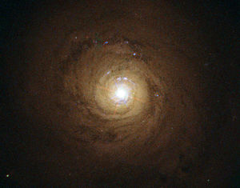
Luminosity
Time

Slide 4
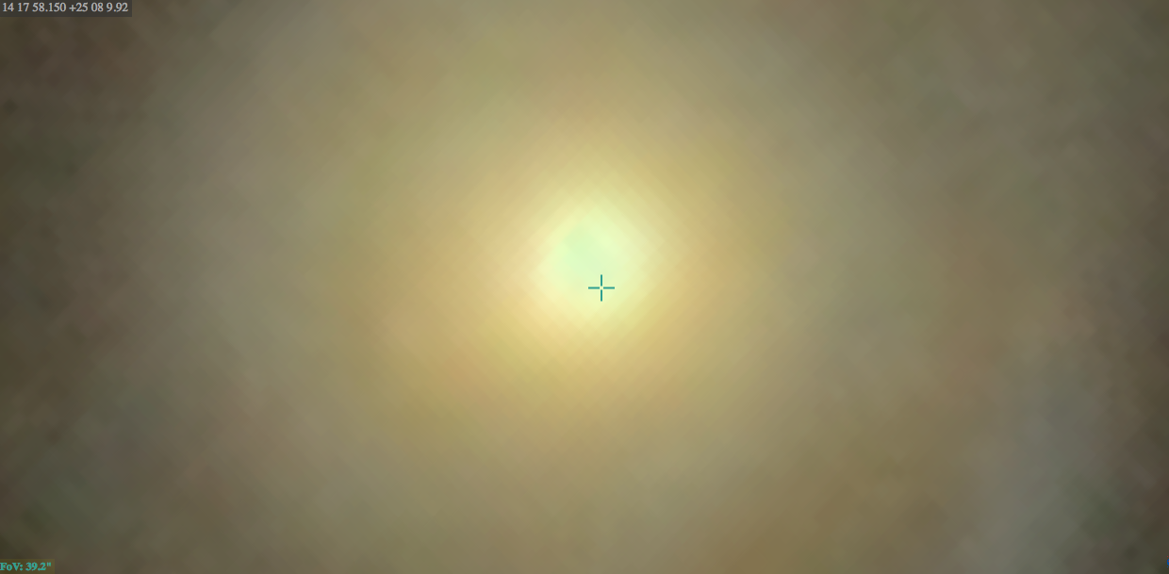

Slide 5
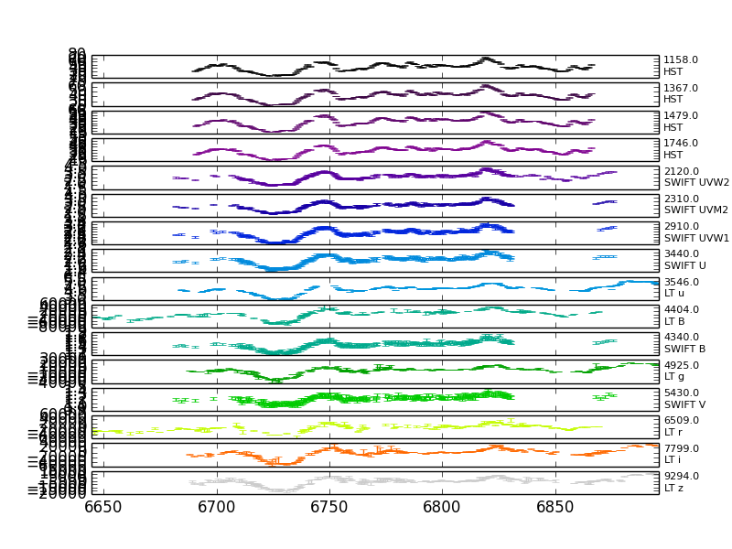
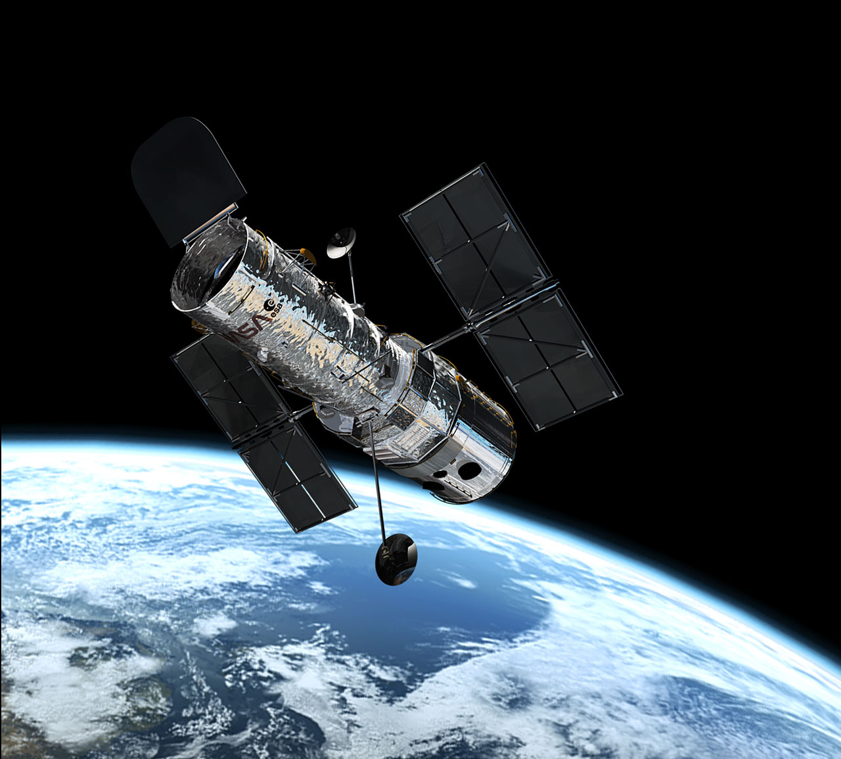
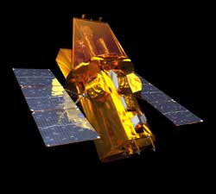
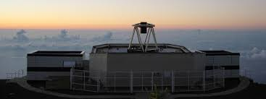
HST: 1000 – 2000 Å
SWIFT: 2000 – 4300 Å
LT: 3500 – 9000 Å
Ground
Time (days)

Slide 6
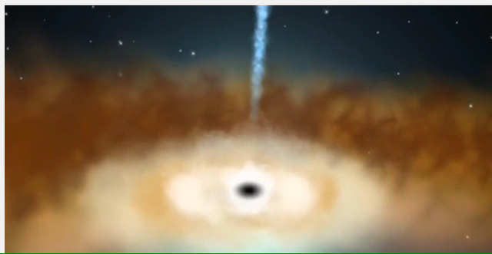
Hot
Cold
Hot short wavelength
Disk light varies from inside → out
From lags we measure Black hole mass, accretion rate, temperature at different radii T(R).
Luminosity
cold long wavelength
Time

Slide 7
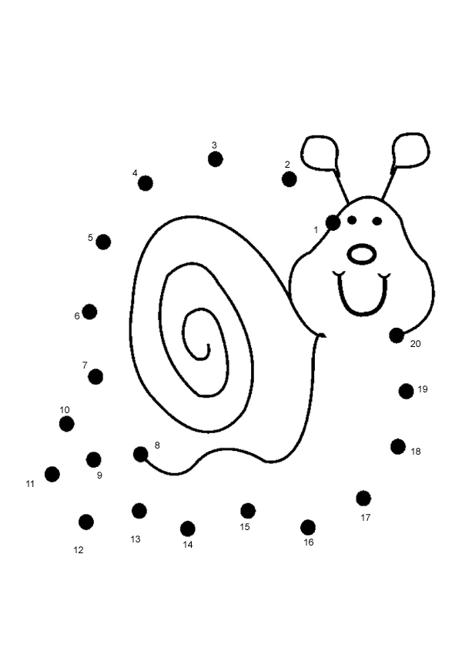
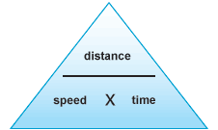
Easy Enough to Learn

